Slide 1
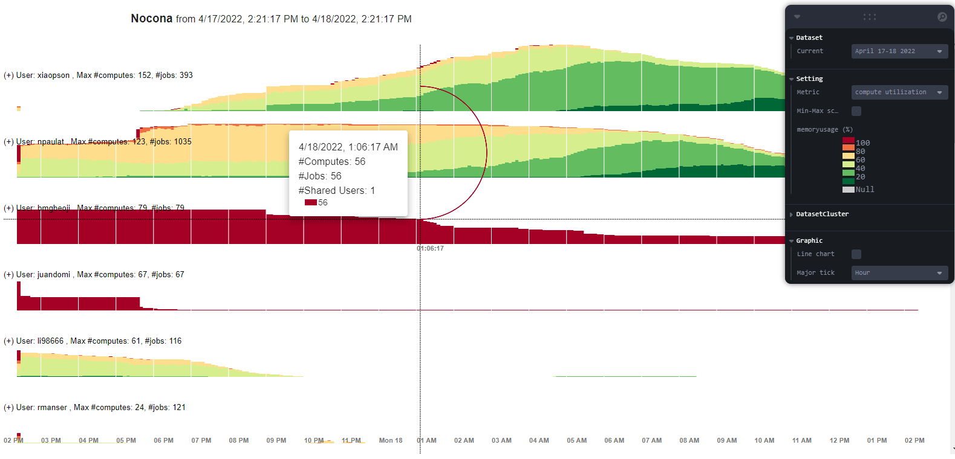
MetricArea
Weekly report

Slide 2
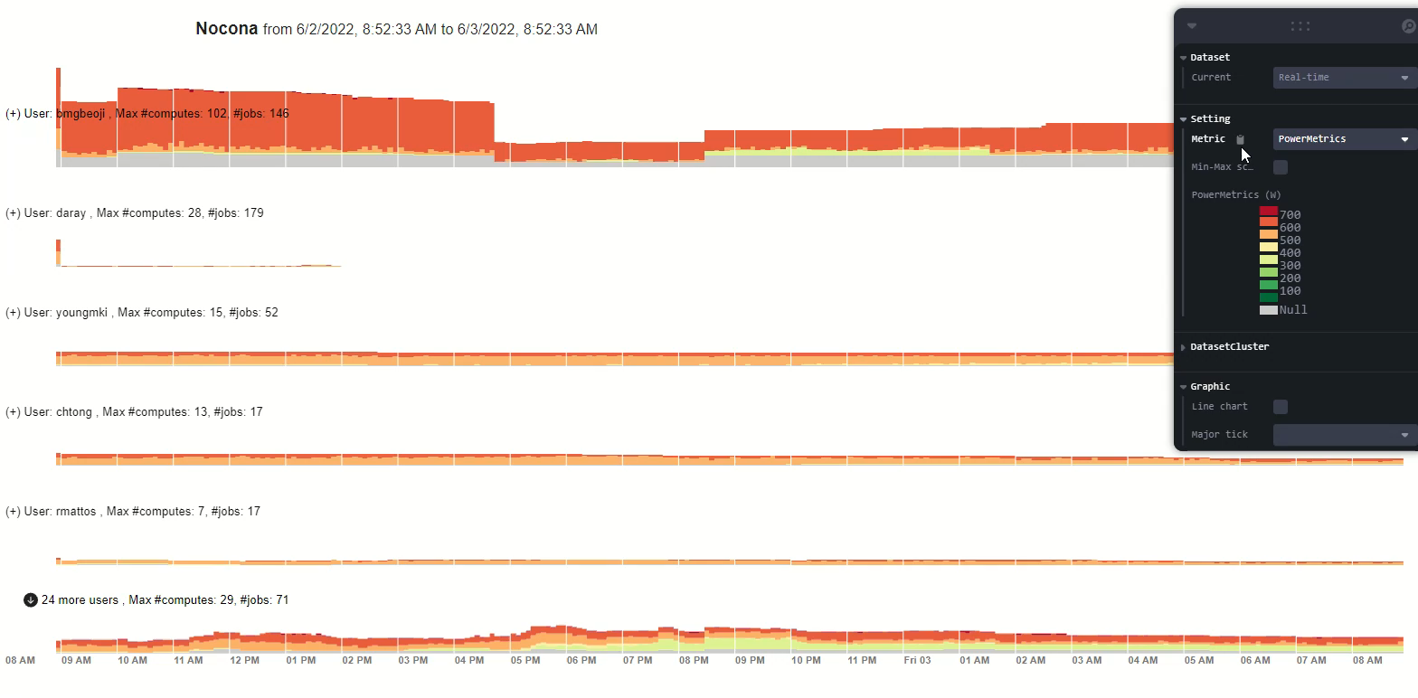
Limit display with summary users

Slide 3

Limit jobs

Slide 4
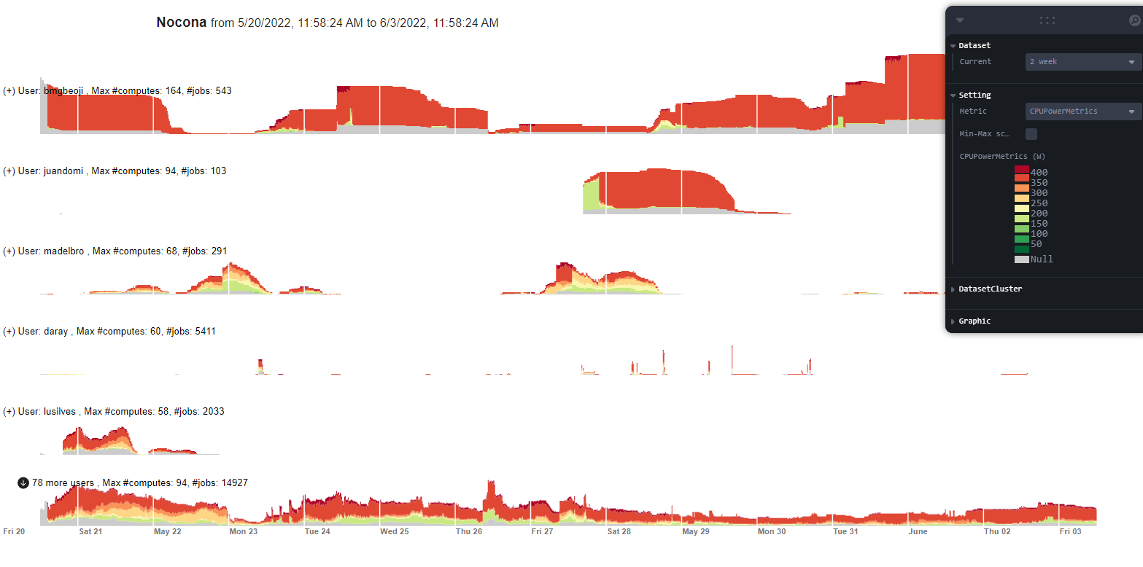
2 weeks

Slide 5
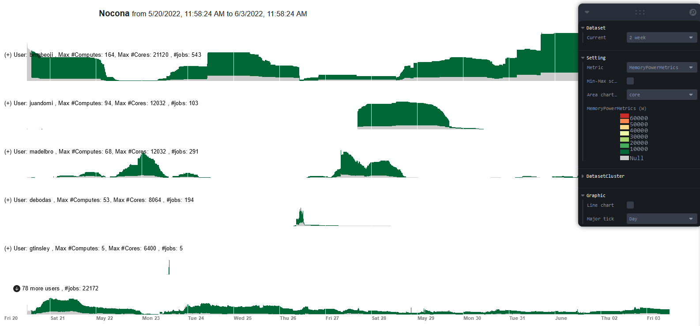
MemoryPowerMetrics

Slide 6
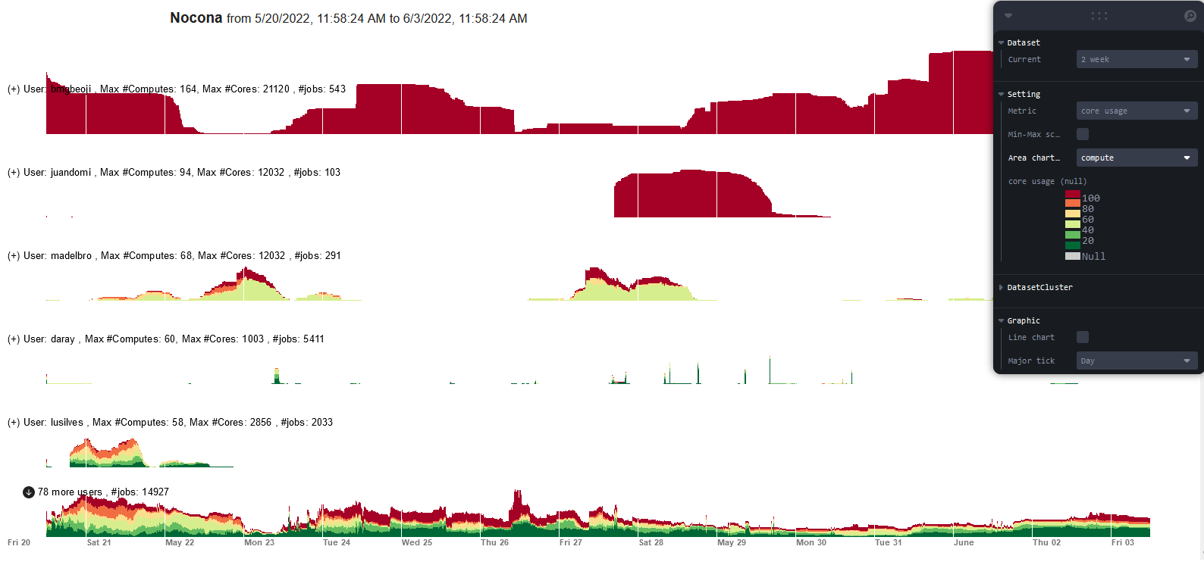
2 weeks
Compute utilization => core usage
Area chart by: #Compute or #Core

Slide 7
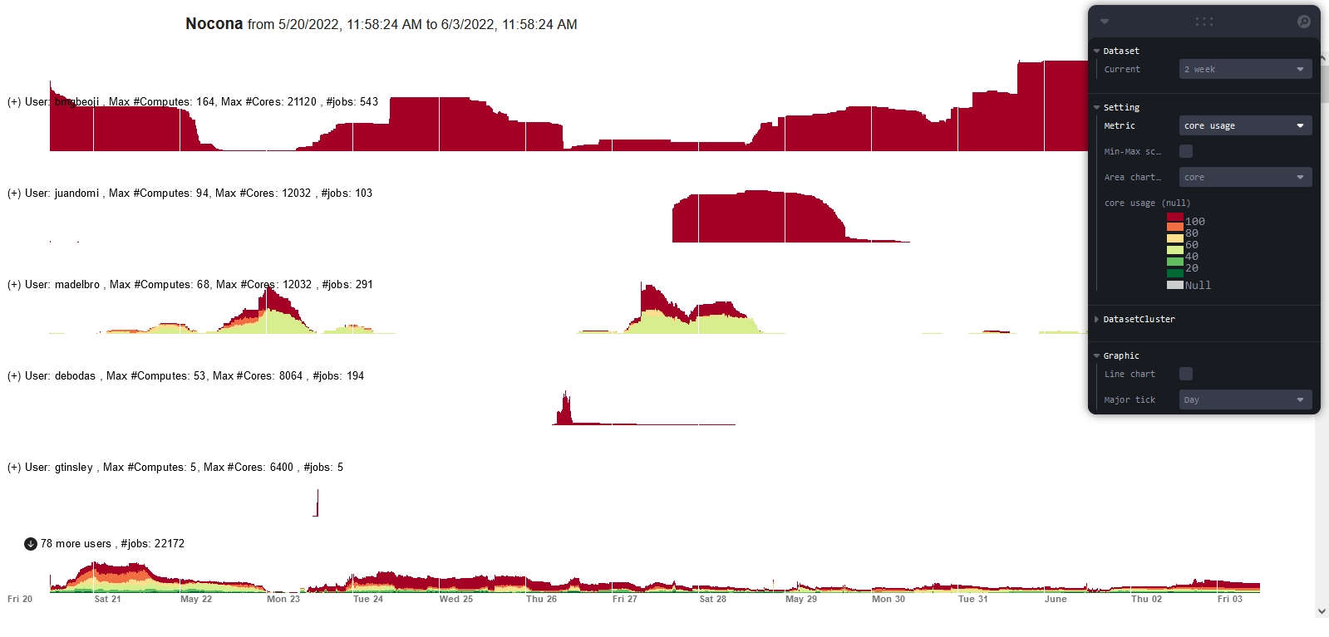
2 weeks
Compute utilization => core usage
Area chart by: #Compute or #Core
Sort by #Core

Slide 8
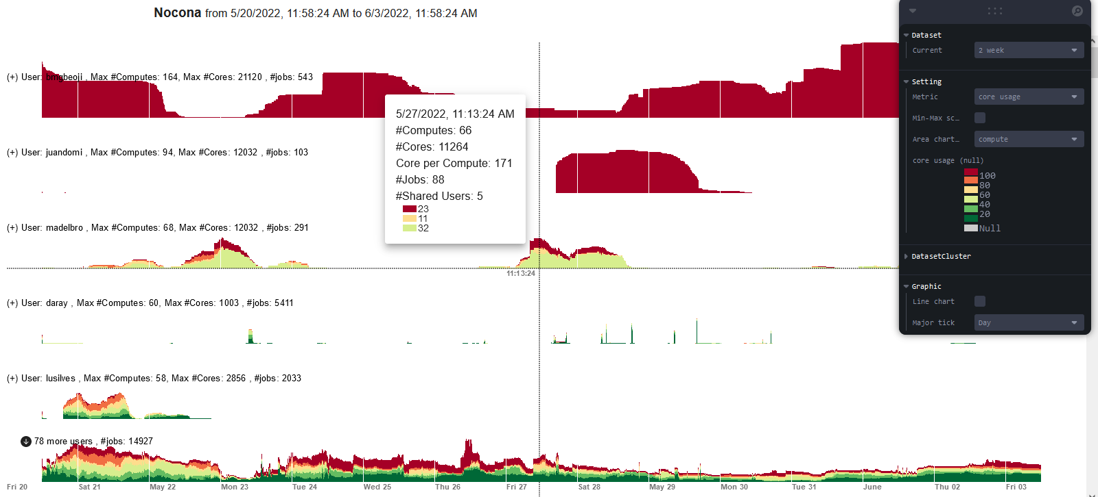
Tooltip update
Add #Core
Add Core per Compute

Slide 9
CPU energy
CPU power of job = CPU power * (#cores/ total current #cores)
Energy (Wh)= Sum of (Sum of CPU power over nodes * timestep) over running time
User 1 has a single Job A running on node 1 and 2 for 2 timesteps.
Each time step is 5 minute. CPU power metric is from iRAC
Node 1: have 2 jobs: Job A (64 cores) and job B (64 cores)
timestep 1: CPU power = 700W
timestep 2: CPU power = 800W
Node 2: have 1 job: Job A (64 cores)
timestep 1: CPU power = 600W
timestep 2: CPU power = 500W
Energy consumed by User 1:
Energy consumed from Node 1: ((700 +800 )* 64/128) *5/60 = 62.5Wh
Energy consumed from Node 2: ((600 +500 )* 64/64) *5/60 = 91.7Wh
Total Energy = 154.2 Wh = 0.154 kWh

Slide 10
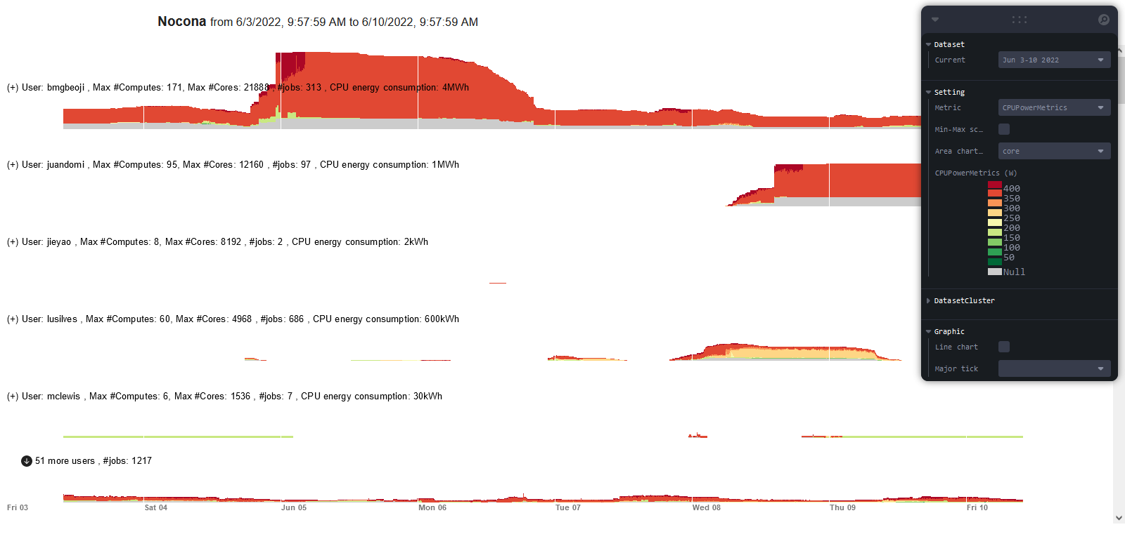
CPU energy
CPU power of job = CPU power * (#cores/ total current #cores)
Energy = Sum of (Sum of CPU power over nodes * timestep) over running time

Slide 11
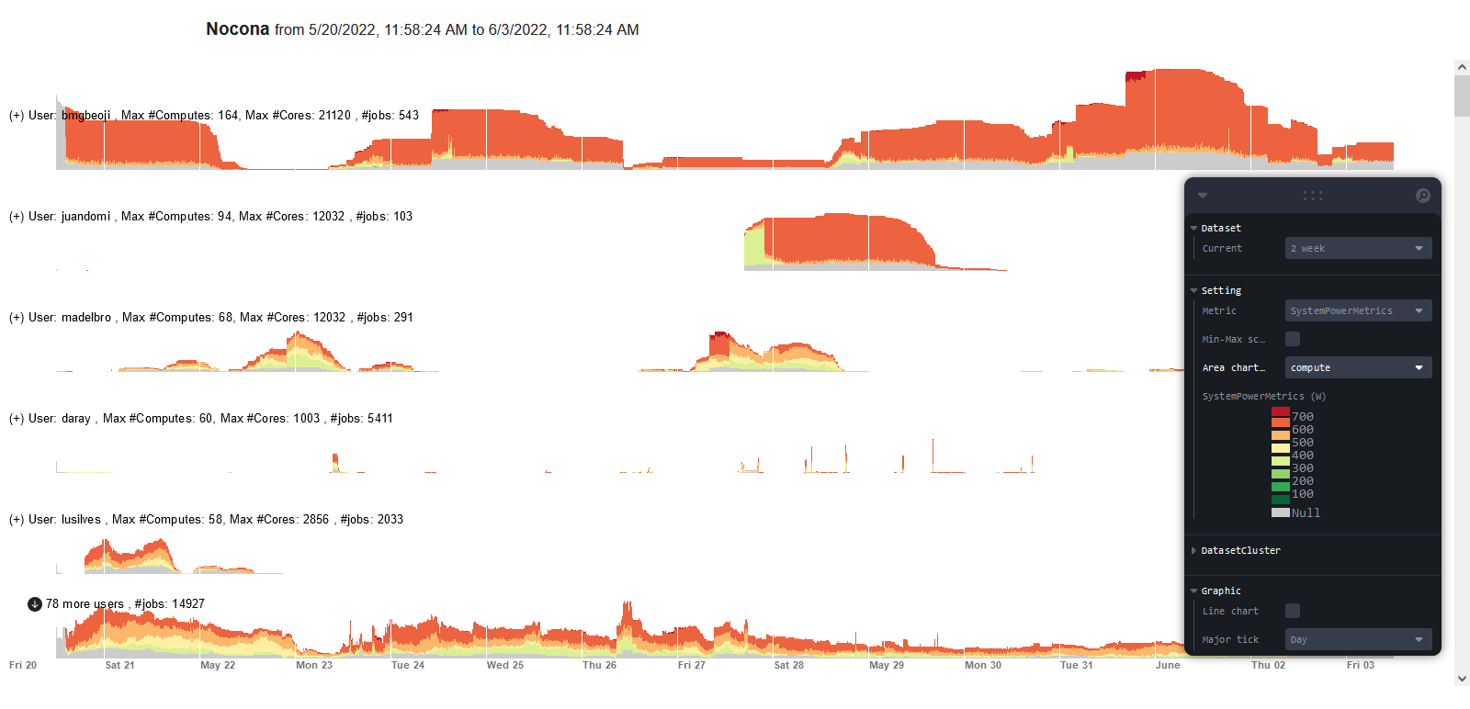
SystemPowerMetrics

Slide 12

SystemPowerMetrics

